Slide 1
Instaventory
A convenience store inventory management solution
Group 3
Olivier Chan - File IO, Linked List
Luis Guerrero - User Interface, User IO
Hiren Rathod - Hash Table
Yue Pan - Binary Search Tree

Slide 2
What is Inventory Management (software)?
Inventory Management
The small or large scale control and overseeing of physical materials and goods.
Examples of use cases:
Helping to decide when to purchase new goods for retail
Calculating profits/margins
Can be accomplished with paper records, spreadsheets, software, etc.

Slide 3
Our solution, “Instaventory”
Inventory Management software
Designed for individual, small scale stores
Gas stations
Convenience stores (7-Eleven, Liquor stores)
Features
Save and load data records from a file
Add and delete data records
View ordered lists of records
View records ordered by profit margin
And more!

Slide 4
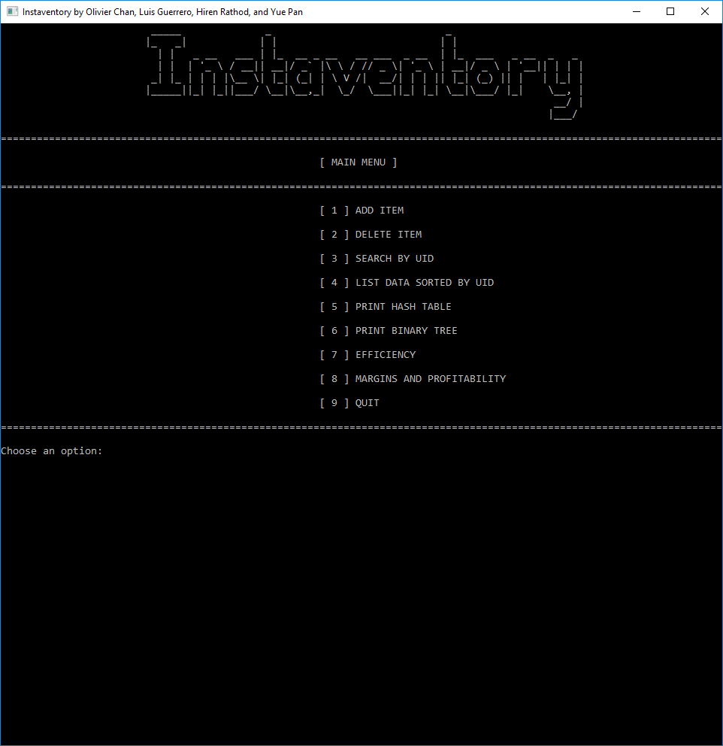
User Interface
Menu / Option based
Navigation by choosing a number option
Input validation
Can’t enter invalid options/data - reason will be given and asked to retry

Slide 5
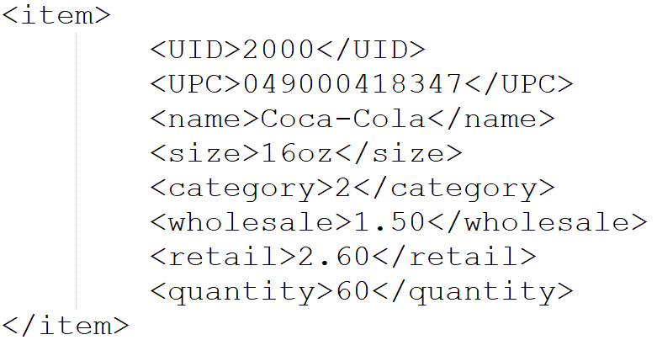
How Products/Items are stored in file
UID - Unique Identifier
UPC - Universal Product Code
A.K.A. Barcode
Name
Size (Number, Weight, Volume)
Category
Snacks
Drinks
Tobacco
Lottery & Scratch Cards
Miscellaneous
Wholesale / Retail Price
Quantity in Stock

Slide 6
Data Structures used in Instaventory
Dynamic Array
Used as the primary structure for storing data
All other ADTs reference from the dynamic array
Linked List
Used in general use cases
Used in hash table ADT for separate chaining
Hash Table
Used to retrieve items by UID efficiently
Binary Search Tree
Used to efficiently print items by sorted profit margins

Slide 7
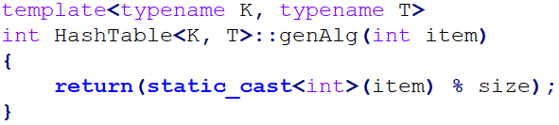
Hash Table
Hash function
Modulo hashing
Collisions
Resolved using separate chaining, hash table is an array of Linked Lists
Examples:
Item UID 1000 gets hashed into 1000 % 101 = 91
Item UID 3005 gets hashed into 3005 % 101 = 76
Item UID 2111 gets hashed into 2111 % 101 = 91 (collision!)
Item 2111 gets “chained” to the end of the list containing Item 1000
Index 91 now contains [91] Item 1000 ---> Item 2111

Slide 8
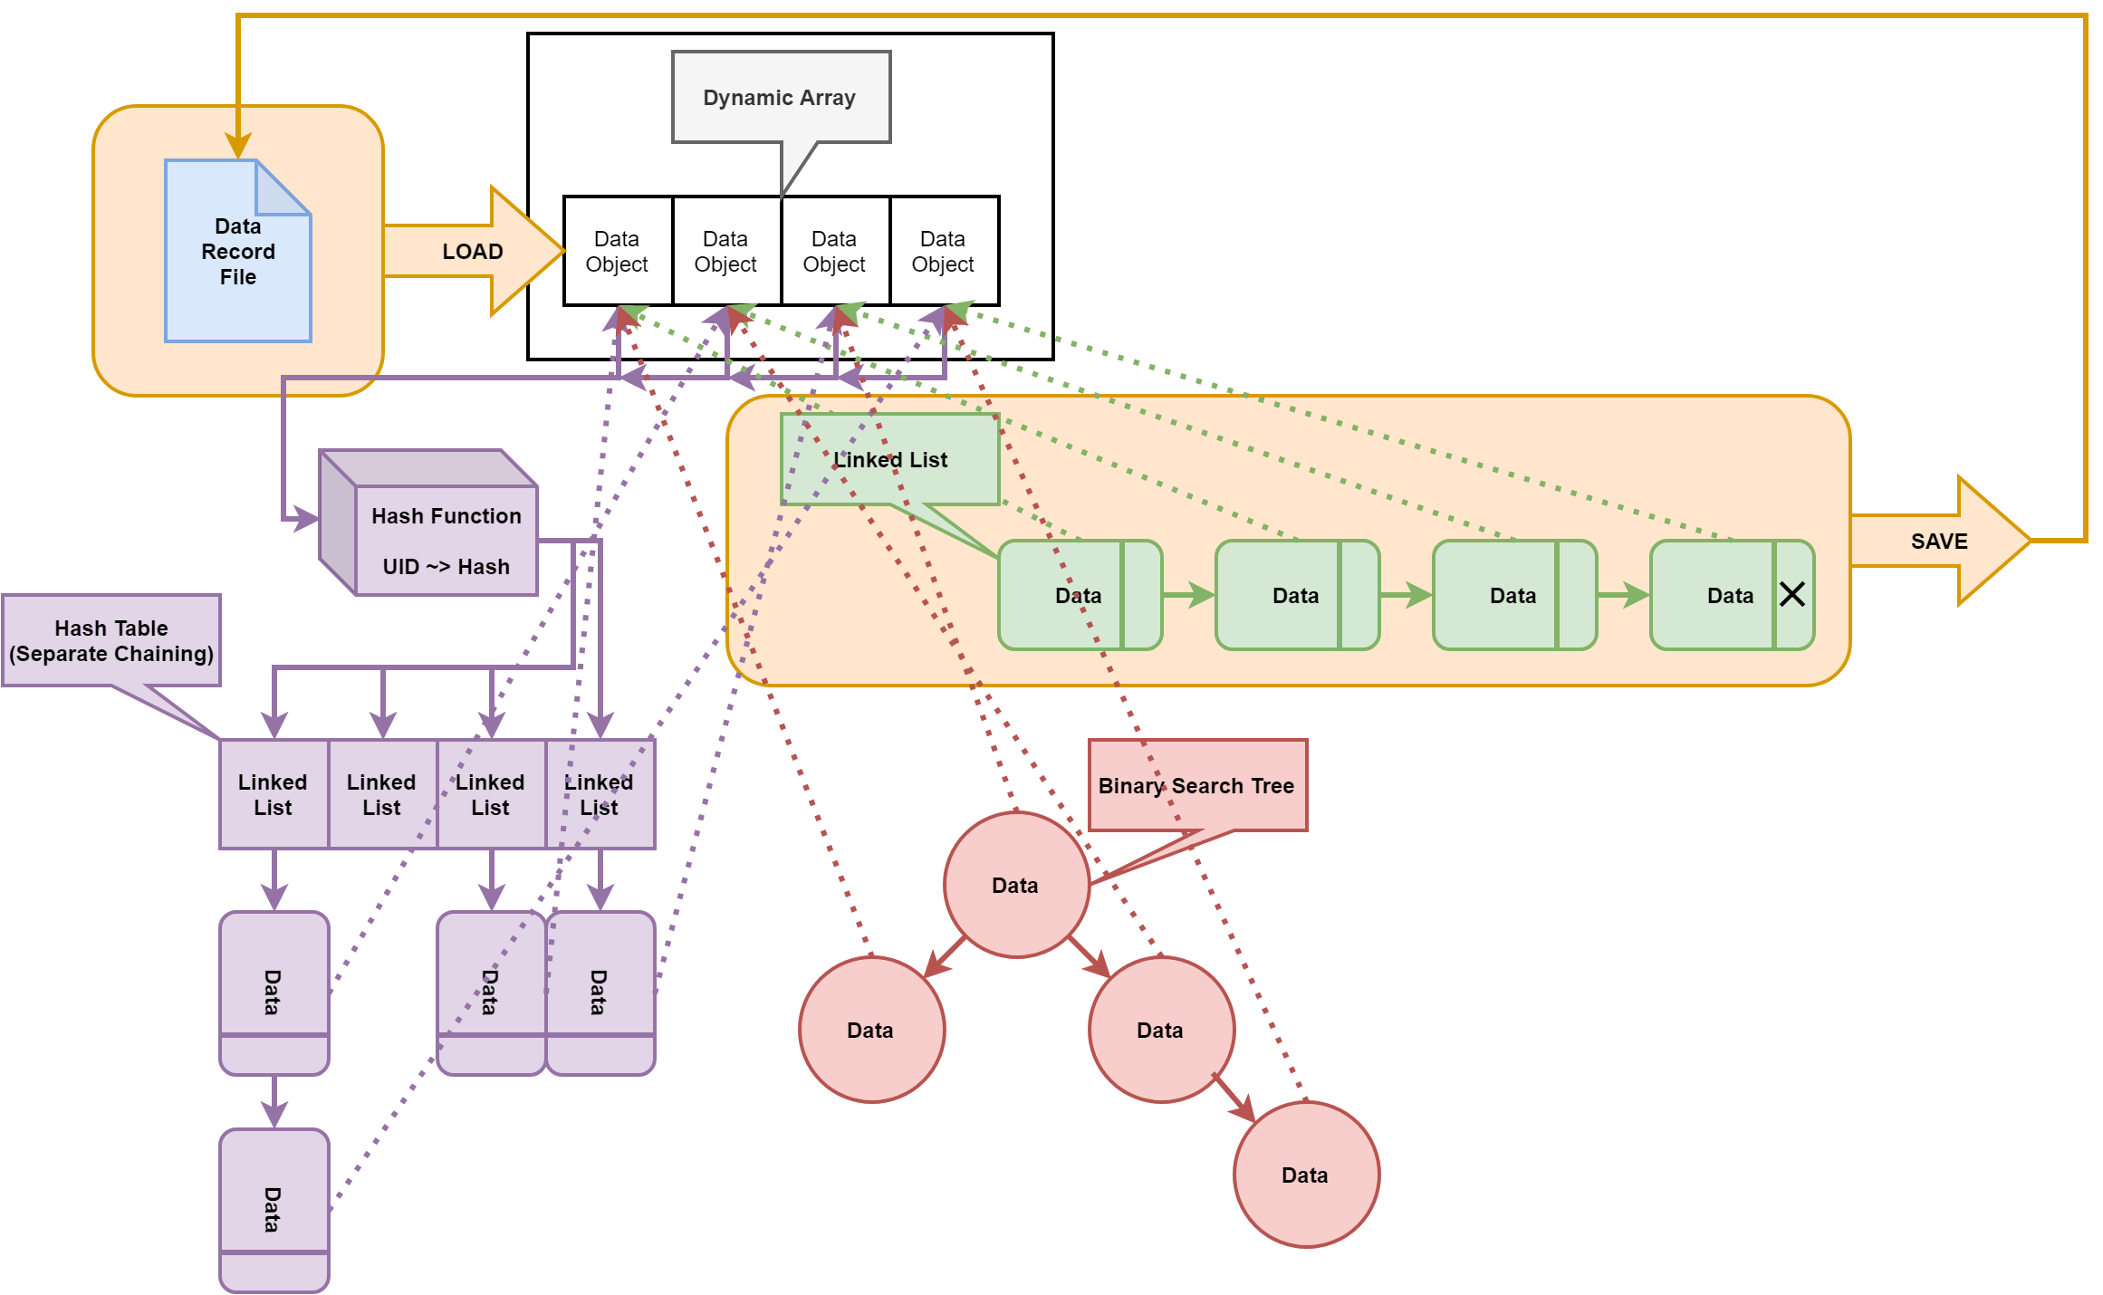
Data Structure Diagram

Slide 9
Demonstration
and
Q&A

